Slide 1
Neural Network Interviews
Do Now: Sit according to the pairs/trios below

Slide 2
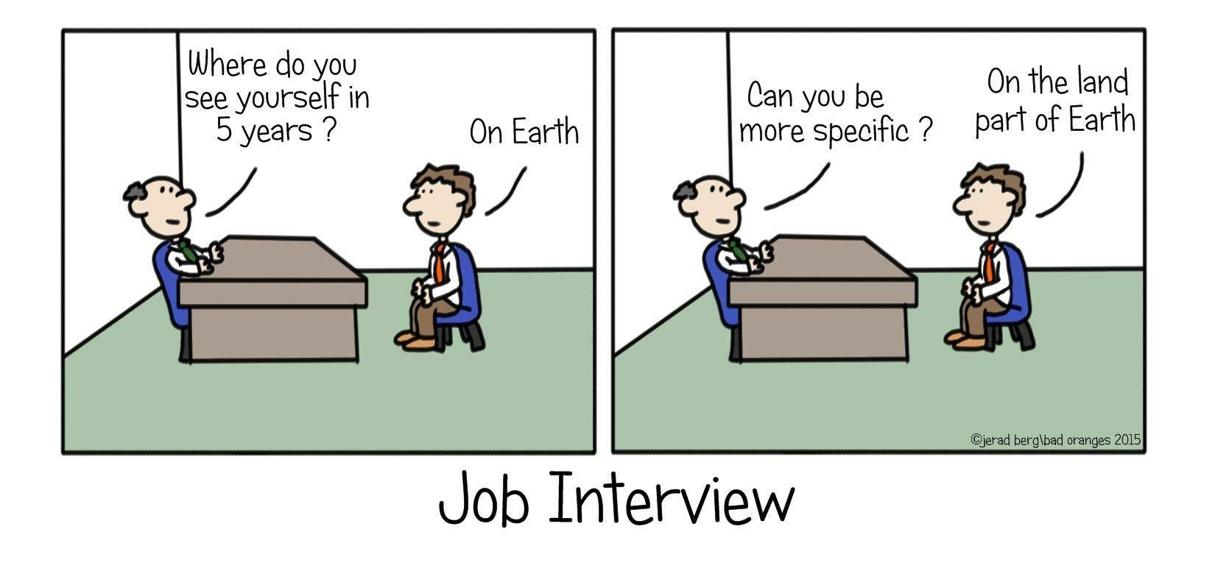
Interviewing Takes Practice
Notes:
This is the hook: you can get better at interviewing by practicing. Talk about your history of interviewing for jobs, and the lessons you learned through experience.

Slide 3
Today’s Learning Goals
Explain what neural networks are, how they work, and their properties
Practice responding to technical interview questions about neural networks
Notes:
Let students in on the design thinking for this lesson: by having them prepare for technical interview questions about neural networks, they will have to refine their conceptual understanding of them as well as develop their communication skills.

Slide 4
Today’s Activity
Activity Goal: Convince your mock interviewer that you have a deep understanding of neural networks.
Work with a partner (8 mins)
Take turns reading aloud your answers to the one question you are assigned
Discuss similarities and differences in your answers
Reconcile your answers and write a revised one-paragraph answer
Write any outstanding questions you have on notecards
Join up with the other group that worked on your question (12 mins)
Repeat the exercise above
Discard any notecards that have been resolved, and write new ones for any new questions. Hand your question notecards to your instructor/DSC
Jigsaw with the other groups that worked on different questions (20 mins)
Each person will take turns presenting their answer to the group
After presenting, presenters will respond to probing or clarifying questions from the group
After questions, each other member of the group will share something they liked/plan to steal
Return to your partner (10 mins)
Each partner will take turns interviewing the other, asking all five questions and any clarifying/probing questions they want
Whole class reflection (5 mins)
Notes:
Activity: Walk through the steps for todays activity. Feel free to add in additional guidance for any of these steps if you feel it would be helpful for your class.

Slide 5
Notes About Today’s Activity
You will become an expert for one question to start
You will need to be able to respond to all questions by the end
Notes:
Notes: This is your chance to head off potential issues.

Slide 6
What makes for a good answer?
Clear: Your audience is able to understand your meaning
Correct: There are no factual inaccuracies
Complete: Directly responds to all parts of the question
Concise: Not repetitive and no extraneous information

Slide 7
Work in pairs to analyze our class’s responses using the Jupyter notebook (35 min)
We have given you code to import and scrub the responses
There are hints at the bottom of the notebook
Raise your hand if you need assistance
Notes:
Put up this slide when you’re ready for students to start working

Slide 8
Pairs join to make groups of four to discuss answers and prepare to share (15 min)
In the next step of this activity, each group will present one recommendation and the findings that support that recommendation
You will have ~1 minute to share, and the class will have ~3 minutes to ask questions
If you want to show text or a visual to the class, please email/Slack it to me
Notes:
Put up this slide when you’re ready to transition to group work. Reinforce the point that you want both the recommendation and the findings that support it. You can let them know that the timing is not strict.

Slide 9
Each group will share with the class one recommendation and supporting findings
You will have ~1 minute to share
The class will have ~3 minutes to ask questions
Notes:
Put up this slide when you’re ready to have groups share out. In total, this section should take about 20 minutes

Slide 10
Discussion
Did you see any overarching themes in our findings or recommendations?
What were some limitations to our analysis? How might you change the survey or analysis to address them?
Could this class graph be useful for anything other than recommendations for me?
Do you think I should actually act on any of your recommendations? Why or why not?
Notes:
Feel free to facilitate this whole group discussion however you like. I recommend going through each question, asking the question out loud to the class, solicit responses, and ask the class what they think of those responses.

